Slide 1
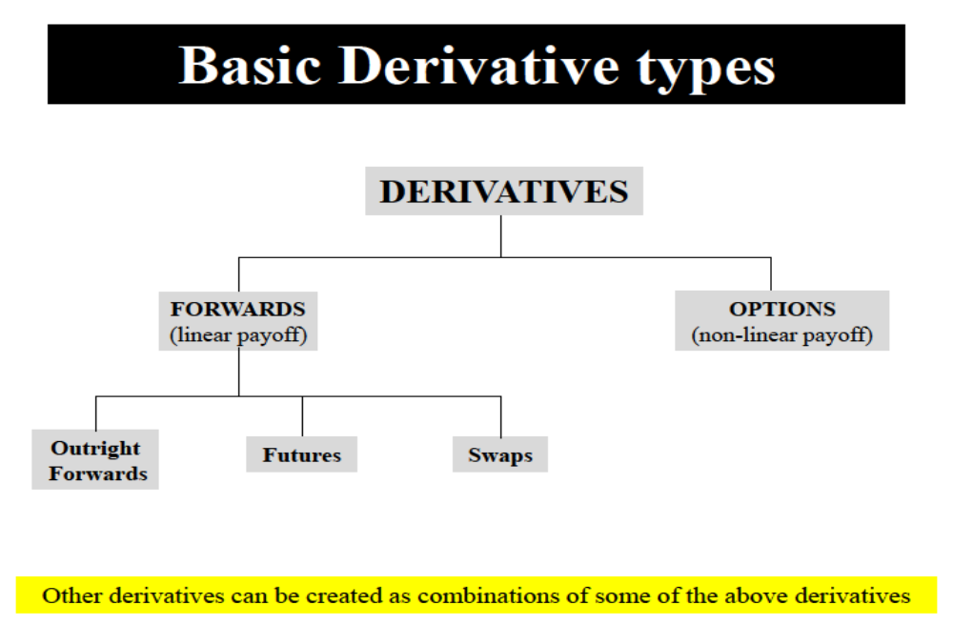


Slide 2
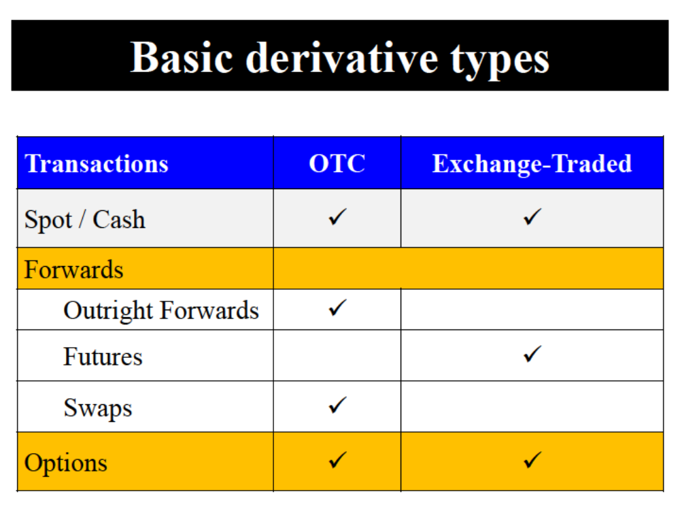

Slide 3
Swaps

Slide 4
Swaps :
Interest Rate Swaps
Currency Swaps

Slide 5
Swaps
Defining Swaps
A Swap is an agreement between two parties to exchange two different forms of payment obligations (cash flows)
A Swap agreement defines following things clearly
-Dates when cash flows are to be paid
-Way of calculating cash flows
Two Types of Swaps
- Interest Rate Swaps: cash flows are in same currency.
- Currency Swaps: cash flows in different currencies.
Note
In Swaps, cash flows generally depend on one or more market variables.
In Swaps, exchange of cash flows typically take place in several future dates.

Slide 6
Swaps
Example 1 (Direct Contact)
-Company A agrees to pay cash flows equal to interest at a predetermined fixed rate (say 5%) on a notional principal for two years to Company B.
-In return Company A receives interest at a floating rate (say, six-month LIBOR) on the same notional principal from Company B, for the same period.
--Suppose they contact/meet directly and enter into a swap agreement on March 5, 2005. Assume exchange takes place every six months
5 %
Company A
Company B
LIBOR
Calculation at Company A (Figures in Per cent)
Date Floating Floating Cash Fixed Cash Net Cash
Rate Flow received Flow paid Flow (received-paid)
--------------- ------------- ------------------- ---------------- ----------------------------
Mar 5, 2005 4.2
Sep 5, 2005 4.8
Mar 5, 2006 5.3
Sep 5, 2006 5.5
Mar 5, 2007 5.6
----------------------------------------------------------------------------------------------------------------
Note: Above swap contract can be thought of as a combination of a long on floating rate bond and a short on fixed rate bond.

Slide 7
Swaps
Example 2 (with Financial Intermediary)
Consider the contract in previous example (example 1). Now assume that a financial intermediary facilitated the swap agreement between Company A and Company B.
Intermediary charge some fees/commission, say 0.03%
Let swap agreement is made equally attractive to both A and B.
5.015%
4.985%
Financial
Institution
A
B
LIBOR
LIBOR
After they enter into swap agreement look at their cash flows
Company A (on a payment date)
Pays 5.015% under swap
Gets LIBOR under swap
----------------------------------------
Net Pays =(5.015%-LIBOR) instead of (5%-LIBOR) in absence of intermediary
Company B (on a payment date)
Pays LIBOR under swap
Gets 4.985% under swap
-------------------------------------------------
Net Pays =(LIBOR-4.985) instead of (LIBOR-5%) in absence of intermediary
Financial Intermediary earns 0.015 % from each party, so its total earning = 0.03 %

Slide 8
Currency Swaps

Slide 9
Currency Swaps
- The Comparative-Advantage Argument
Suppose Company A wants to borrow AUD 20 million and Company B wants to borrow USD 12 million.
Assume current exchange rate (USD per AUD) is 0.6000 (so, AUD 20 million is equivalent to USD 12 million today).
Consider the borrowing rates (adjusted to reflect differential impact of taxes) offered to two companies
Company USD AUD
---------------- ------------------ ------------------------------
A 5.0% 12.6 %
B 7.0% 13.0%
----------------------------------------------------------------------
Note the following
Company A has comparative-advantage in USD market & Company B has comparative advantage in AUD market.
So, A borrows at 5% from USD market and B borrows at 13% from AUD market.
They then enter into swap agreement so that A ends up with a AUD borrowing and B with USD borrowing.
Consider there is a Financial Institute who plays the role of intermediary.

Slide 10
Currency Swaps
- The Comparative-Advantage Argument
Designing currency swap Agreement for A & B
-Total gain to all involved is 2% - 0.4%=1.6%.
-Let swap agreement is made equally attractive to both A and B.
AUD 11.9%
AUD 13%
USD 5 %
Financial
Institution
AUD 13%
A
B
USD 5%
USD 6.3%
After they enter into swap agreement look at their cash flows
Company A (on a payment date)
Pays USD 5% on Direct USD borrowing
Pays AUD 11.9% under swap
Gets USD 5% under swap
----------------------------------------
Net Pays =AUD 11.9 %
This is 0.7% lower than AUD 12.6% it would pay on direct AUD borrowing
Company B (on a payment date)
Pays AUD 13% on direct AUD borrowing
Pays USD 6.3% under swap
Gets AUD 13% under swap
-------------------------------------------------
Net Pays =USD 6.3%
This is 0.7% lower than USD 7% it would pay if borrowed USD directly
Financial Intermediary earns (USD 1.3% - AUD 1.1%) ≅ 0.2% if ignore differences in currencies

Slide 11
How does a structured product work?
Best example: Equity linked debentures
Let us take the example of a simple Nifty-linked capital protection structure. Say, you invest INR 100 in a product with tenure of 36 months. Of this, INR 80 is invested in debt securities, yielding a return of 7-8% per annum. Thus over a period of 36 months, you could get INR 20 as interest on these debt securities.

Slide 12
Structured Product
Hence, this ensures that your capital of INR 100 is protected. The balance of INR 20 available is invested in the Nifty. If the Nifty doubles in 40 months, INR 20 will become INR 40. Thus the value of your INR 100 will be INR 140 at the end of the period giving you an absolute return of 40%.

Slide 13
Structured Product
On the other hand, if the Nifty were to fall by say 50%, then INR 20 invested would become INR 10, thereby giving you INR 110 back. This strategy ensures that at any given time, your capital is protected and you will get INR 100 back at the end of 36 months.

